Slide 1
Wage Searchers
Module 3 · Video 4
Management 405
Prof. Nico Voigtländer · UCLA Anderson

Slide 2
Module 3 · Agenda
Outline of Module 3
1
Introduction to Module 3
Video 1
2
The Production Function
Video 2
3
Short Run: Hiring Decisions
Video 3
4
Wage Searchers
When hiring one more worker bids up the wage for everyone
Video 4
5
Long Run: The Optimal Input Mix
Video 5
6
Cost Concepts
Video 6
7
Economies of Scale and Scope
Video 7
Management 405 · Module 3 · Production and Costs
2
Notes:
One more wrinkle before we leave the short run. Everything so far assumed the firm can hire as many people as it wants at the going wage. That is fine for a small employer. It is not fine for a firm that is large in its local labor market, or that is bidding for very scarce talent. There the next hire raises the wage for everyone, and the true cost of that hire is well above the wage on the offer letter. That is what a wage searcher faces, and it is what the next few slides work out.

Slide 3
Module 3 · Wage Searchers
The Case of Wage Searchers
So far, we've assumed wages are constant
Realistic for a small firm hiring at the market wage
For a large firm (relative to the local labor market), hiring more workers can push the wage up
Example: a local hospital hiring highly specialized surgeons
Example: a frontier AI lab adding 100 senior researchers in one year
Term: the firm is a wage searcher (not a wage taker)
The true marginal cost of labor includes the wage-bid-up effect for other workers
For a wage searcher, the wage rate is upward-sloping in employment
Management 405 · Module 3 · Production and Costs
3
Notes:
One assumption deserves a second look. So far we have treated the wage as a constant that the firm simply takes as given. That is fine for a small firm hiring a few people at the going market rate. But a firm that is large relative to its local labor market can push the wage up when it hires a lot. Think of a regional hospital that needs twenty more specialized surgeons, or a frontier AI lab adding a hundred senior researchers in a single year. They cannot fill those seats at yesterday's wage. They have to bid the wage up. We call such a firm a wage searcher rather than a wage taker, because it effectively faces a wage that rises as it hires more. And that means the true marginal cost of labor is higher than the wage on the offer letter, because hiring one more person can raise what you pay everyone. The next example makes that concrete.

Slide 4
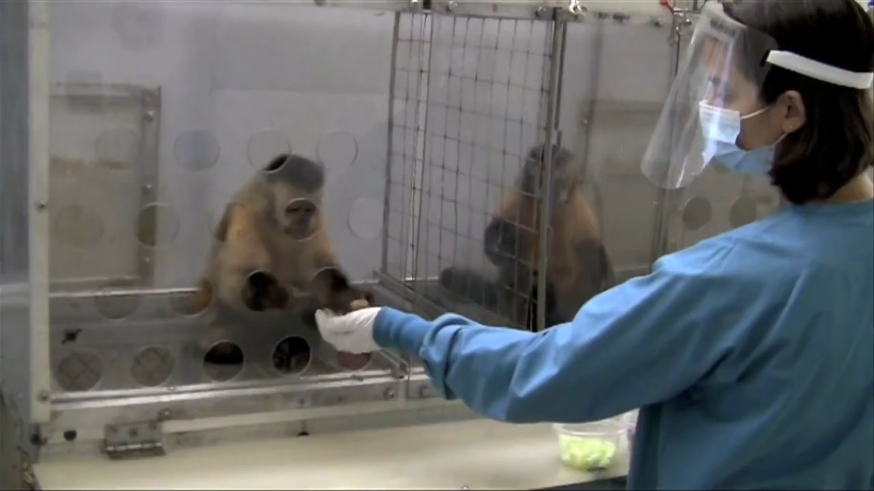
Module 3 · Wage Searchers
Wage Searcher: Nobody Likes Being Treated Unequally…
Management 405 · Module 3 · Production and Costs
4
Notes:
Before the example, one practical wrinkle. When a firm bids up the wage to attract new hires, it usually cannot pay the new people more while keeping the existing staff on the old wage. People find out, and nobody likes being paid less than the person doing the same job right next to them. So the raise tends to spread to the whole team. The broader pattern in the data lines up with this. Larger firms tend to pay more, which is consistent with the wage-search story, though of course other things matter too, like productivity, location, and benefits. Keep that ripple effect in mind for the example coming up.

Slide 5

Module 3 · Wage Searchers
Example: The Full Cost of a New Rivian Designer
Rivian is trying to hire a star designer from BMW for its next models
Designer says she’d be willing to join for $2M annual salary
Rivian already employs 2 star designers, each earning $1.5M
If the new designer is hired, the two existing ones would demand the same salary
→ What is the marginal cost of the 3rd designer?
Poll Break
Management 405 · Module 3 · Production and Costs
5
Notes:
Here is what wage searching looks like when you are the one doing the hiring. Rivian wants a star designer for its next models, and the person it wants sits at BMW. She tells Rivian she would come for 2 million dollars a year. Now look at the second half of the slide. Rivian already has 2 star designers on the payroll, each on 1.5 million. The moment the new designer walks in on 2 million, those 2 are going to want the same. So the question is not what she costs. The question is what the third designer costs Rivian in total. Work that number out before we turn the page.

Slide 6
Module 3 · Wage Searchers
Solution: Marginal Cost of the 3rd Designer = $3M
The star designer herself is paid $2M
The two existing designers each get a raise of ($2M − $1.5M) = $0.5M
Total extra wage bill: $2M + 2 × $0.5M
Full Marginal Cost of the 3rd designer = $3M
Take-Away: Big buyers of scarce talent can affect wages — factor it in
Poll Break
Management 405 · Module 3 · Production and Costs
6
Notes:
Here is the full cost. The designer herself has to be paid her 2 million. But the 2 designers already at Rivian now move from 1.5 million up to 2 million as well, which is half a million extra each. So the extra wage bill is her 2 million plus 2 times half a million. That comes to 3 million dollars. The marginal cost of the third designer is 3 million, not the 2 million on her contract. That is the wage-searcher point. Rivian is large enough in this very thin market for top automotive designers that its own hiring moves the wage it has to pay everyone. If you are a big buyer of something scarce, your own purchase changes the price, and the decision has to be made on the full cost rather than the sticker price.

